Slide 1
Brain Neural Activity and Connectivity Revealed by fMRI Study
2024.1.27
Group members: Liu Ziyu, Liu Binbin, Shao Zejie

Slide 2
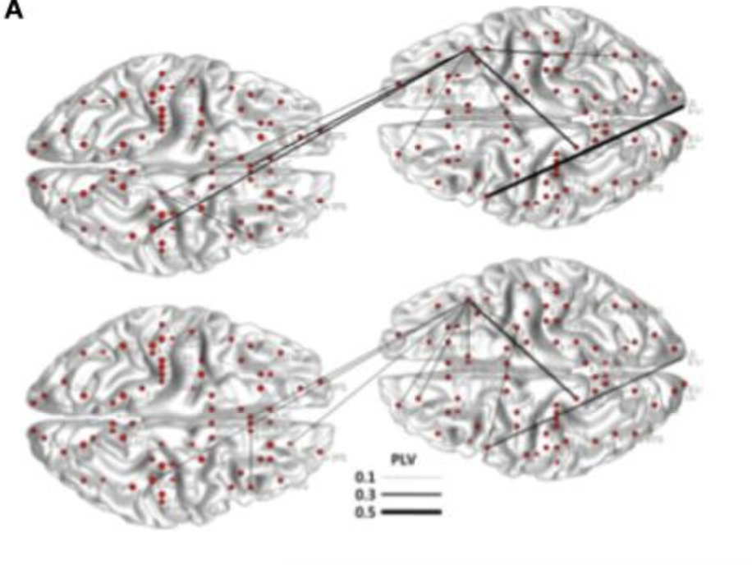
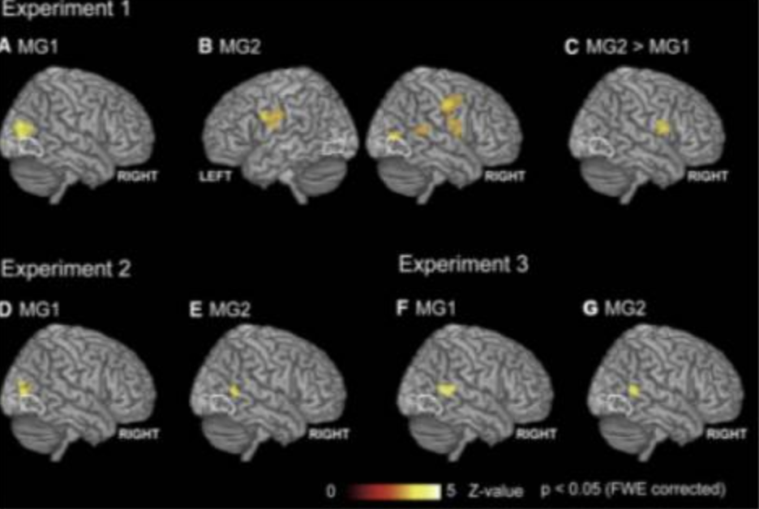
Introduction
Human social interaction and teamwork have great social and evolutionary significance, but studying how to find their neural correlates is very challenging. One reason is that multiple subjects need to be imaged simultaneously. There have been some studies using multiple fMRI technologies to test the interaction between multiple participants. By studying BOLD and correlation analysis when subjects socialize or collaborate, they explore the brain areas and correlations that mainly affect socialization and collaboration. Neural connections are studied using some analysis methods such as correlation analysis, phase synchronization, etc.
A. Analysis methods used in hyperscanning to investigate between brain relationships.
B. From Koike et al. (2016). Between-brain synchronization estimated with correlation.
#1

Slide 3
Reference
Jo, H., Chen, CY., Chen, DY. et al. A brain network that supports consensus-seeking and conflict-resolving of college couples’ shopping interaction. Sci Rep 10, 17601 (2020). https://doi.org/10.1038/s41598-020-74699-1
Shen, S., Cheng, J., Hsu, Y., Chen, D., Weng, M., & Kung, C. (2021). Collaborations and deceptions in strategic interactions revealed by hyperscanning fMRI. bioRxiv.

Slide 4
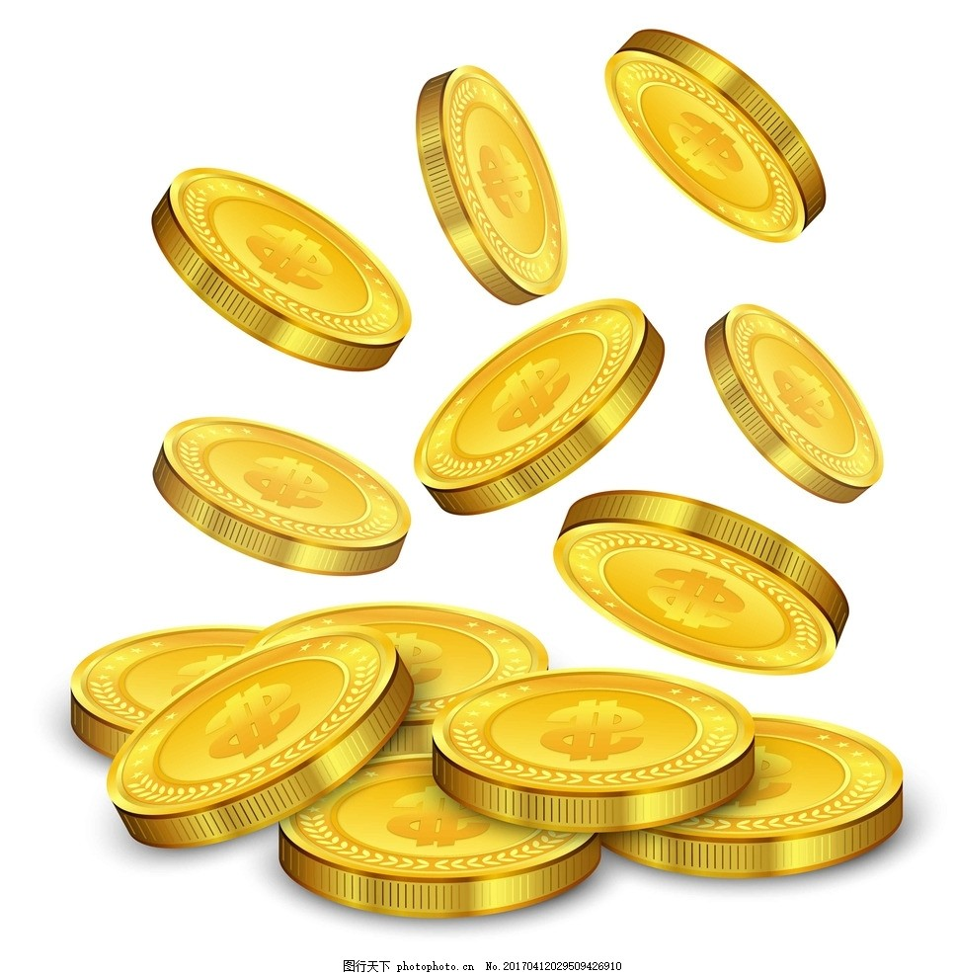

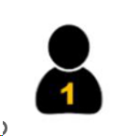

fMRI task1: Opening-treasure-chest(OTC)
Game participants: 66 (33 pairs), aged between 20 and 30 years old. All participants had normal or corrected-to-normal vision and no history of mental illness or neurological disease.
💡
💡
？
？
sender
receiver
sender
receiver
（a） In cooperative mode: If you successfully guess the treasure chest correctly, the two people will share the reward equally.
（b） In competition mode: the receiver chooses the correct treasure box and gets all the rewards; otherwise the sender gets all the rewards.

Slide 5
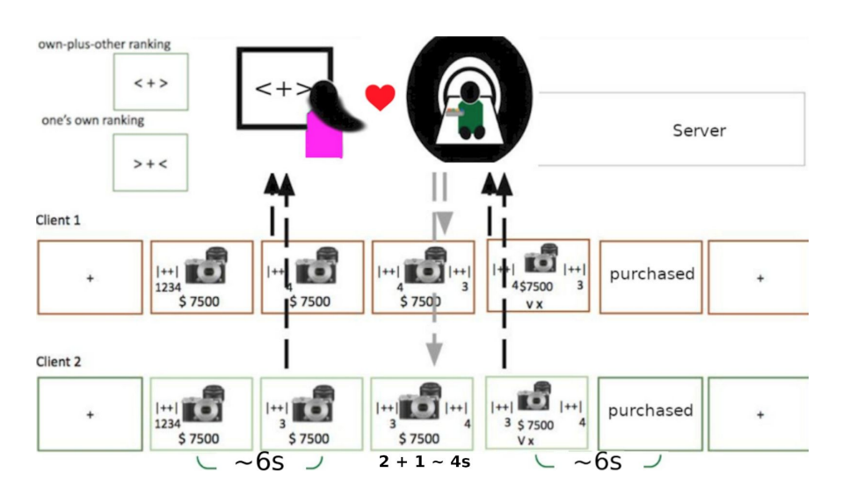
fMRI task2: Shopping Interaction
Picture from Consensus-seeking and conflict-resolving —an fMRI study on college couples’ shopping interaction

Slide 6
Dataset 1: OTC
Sixty-six (33 pairs) participants, between 20 and 30 years of age (M=23.4, SD=2.9), participated in the study. They were recruited from National Taiwan University (NTU), Taipei, and National Cheng Kung University (NCKU), Tainan. All participants were native Taiwanese speakers, who had normal or corrected-to-normal vision, and reported no history of psychiatric or neurological disorders. All methods and procedures were performed following the relevant guidelines and regulations approved by the NCKU Governance Framework for Human Research Ethics https://rec.chass.ncku.edu.tw/en, with the case number 106- 254. After the fMRI experiment, each participant received 600 $NTD, plus the bonus calculated by the sum of won money divided by 112 (total trial number), around 300 $NTD. fMRI data were acquired with a 3 T General Electric 750 MRI scanner (GE Medical Systems, Waukesha, WI) located in the B3F ofthe NCKU MRI center (http://fmri.ncku.edu.tw), equipped with a standard 8-channel head coil. Whole-brain functional scans were acquired with a T2* EPI (TR = 2s, TE = 33ms, flip angle = 90 deg, 40 axial slices, voxel size = 3.5 x 3.5 x 3 mm3).Highresolution T1-weighted structural scans were acquired using a 3D fast spoiled grass (FSPGR) sequence (TR = 7.65 ms, TE =2.93 ms, inversion time = 450 ms, FA = 12 degree, 166 sagittal slices, voxel size = 0.875 x 0.875 x 1 mm3). Another scanner isthe 3-Tesla PRISMA MRI (Siemens, Erlangen, Germany) located at the National Taiwan University(http://mrimeg.psy.ntu.edu.tw/doku.php), equipped with a 20-channel phase array coil. Whole brain functional scans were acquired with a T2* EPI (TR = 2s, TE = 24 ms, flip angle = 87 degree, 36 axial slices, voxelsize = 3 x 3 x 3 mm3). High-resolution structural scans were acquired using a T1-weighted (MP-RAGE) sequence (TR = 2s, TE = 2.3ms, inversion time = 900ms, FA = 8 deg, 192 sagittal slices, voxel size = 0.938 x 0.938 x 0.94 mm3).
https://openneuro.org/datasets/ds004103/versions/1.0.0

Slide 7
Dataset 2: Shopping Interaction
Thirty healthy adults (16 males; mean age=22.7±2.57 yrs, out of the 22 participating couples), who were recruited via online ads and snowball sampling methods, joined the fMRI experiment taking place at the Mind Research and Imaging (MRI) Center, National Cheng Kung University (NCKU). Eligible couples were to be in a romantic relationship for at least a year, with normal or correctedto-normal vision, and no known neurological disorders. All participants provided written informed consent prior to the study. All methods and procedures were approved by NCKU Governance Framework for Human Research Ethics (number 104-206).
The imaging data were obtained using a 3T General Electric 750 MRI scanner (GE Medical Systems, Waukesha, WI) at the NCKU MRI center, utilizing a standard 8-channel head coil. Whole-brain functional scans were conducted with a T2*-weighted EPI sequence (TR=2 s, TE=35 ms, flip angle = 76 degrees, 40 axial slices, voxel size = 3 x 3 x 3 mm³). High-resolution structural scans were acquired using a T1-weighted spoiled grass (SPGR) sequence (TR=7.5s, TE=7.7ms, 166 sagittal slices, voxel size = 1 x 1 x 1 mm³).

Slide 8
Region of Interests
TPJ(Temporo-parietal junction): Attention and social cognition
IPL(Inferior parietal lobule): Motivation
STG(Superior temporalis inferior): Emotion and rhythm
PCC(Posterior Parietal Cortex): Receive the information
Precuneus: High-Level cognition
mPFC(medial prefrontal cortex ): Cognition, decision, social behavior and emotion.
dmPFC(Dorsomedial prefrontal cortex): Cognition study

Slide 9
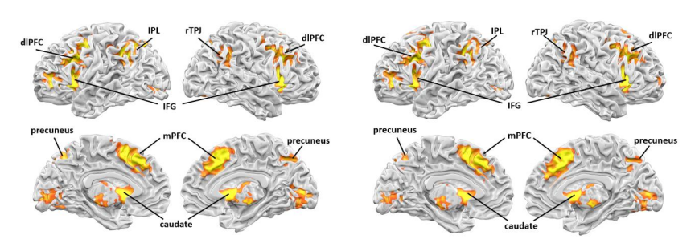
GLM analysis results of OTC.
The contrast in the competition versus cooperation interactions during senders’ decision phase and the contrast when the sender used truth-telling strategies in the competition and the cooperation
This picture is from the paper “Collaborations and deceptions in strategic interactions revealed by hyperscanning fMRI”

Slide 10
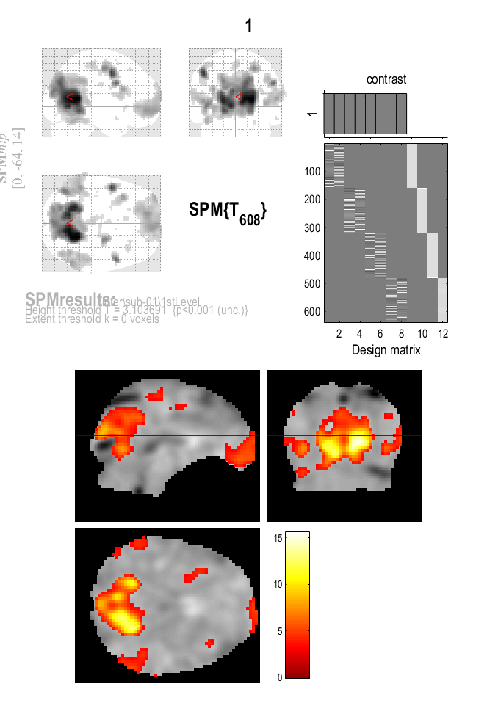
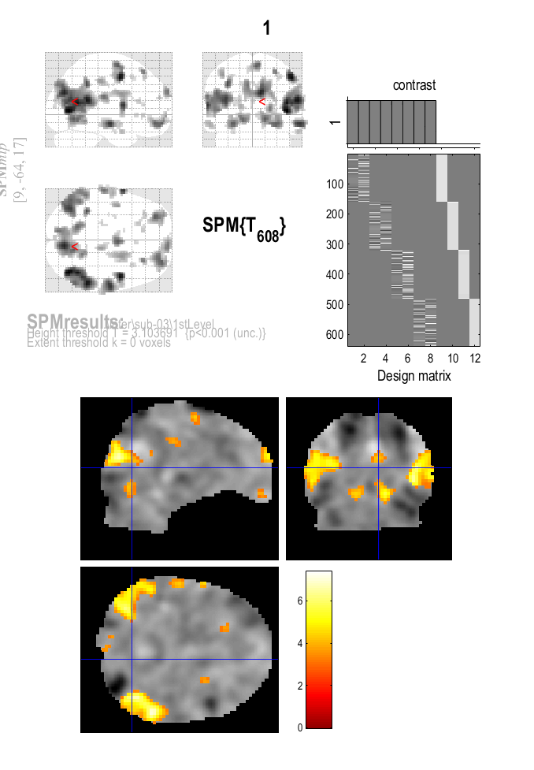
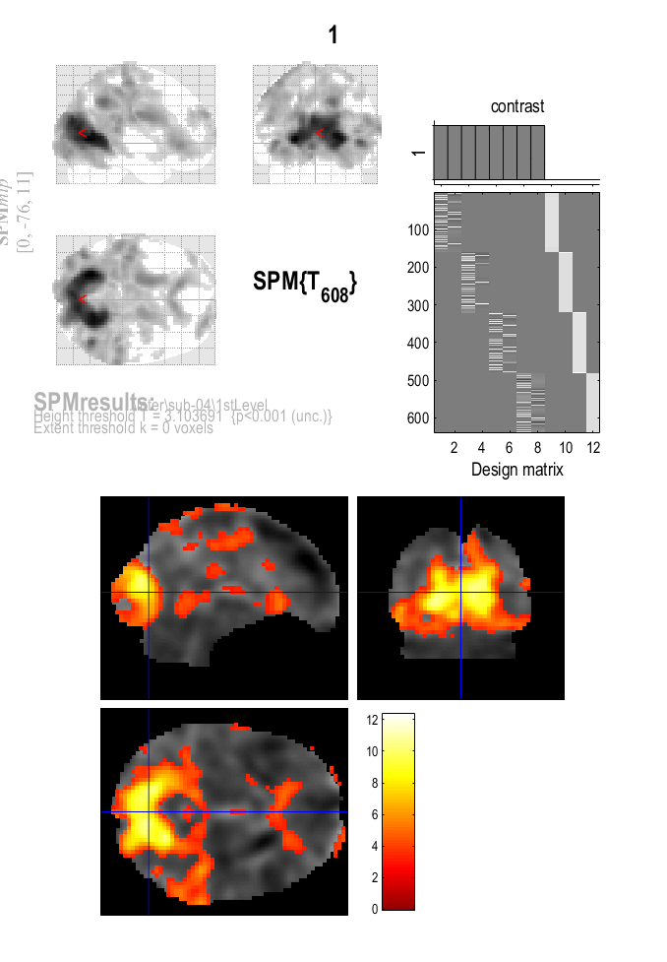
GLM analysis results of Shopping Interaction.

Slide 11
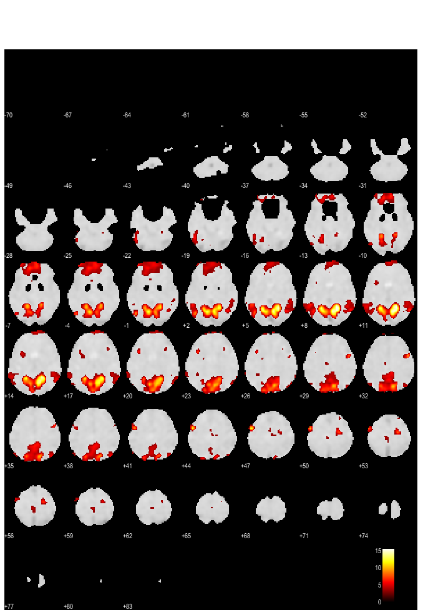
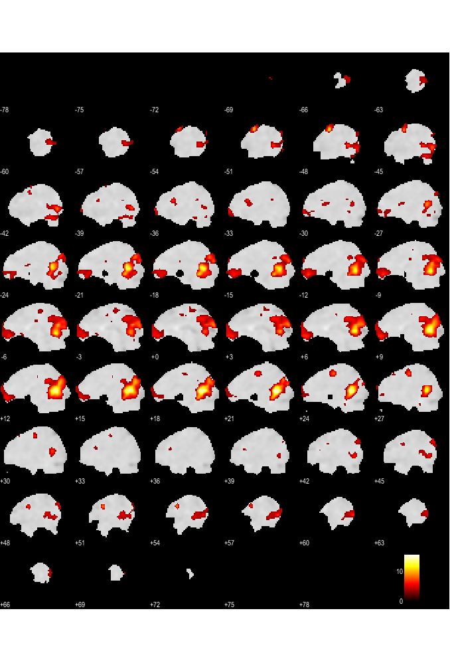
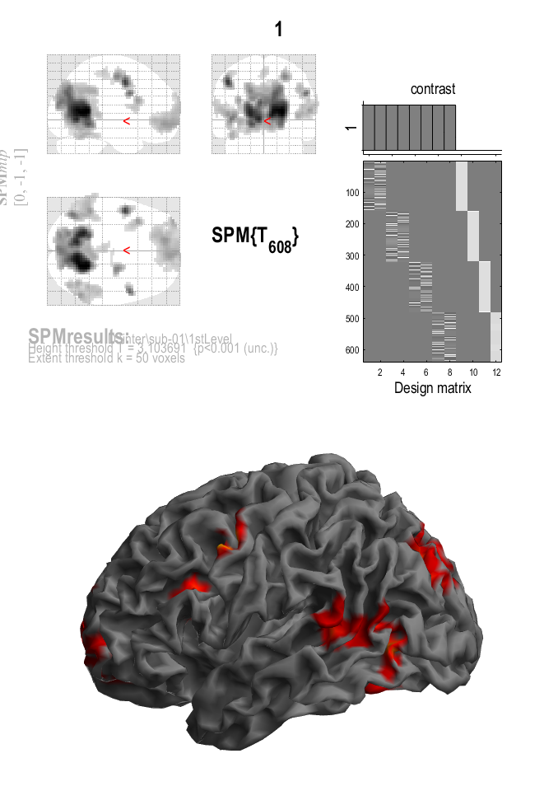
GLM analysis results of Shopping Interaction.

Slide 12
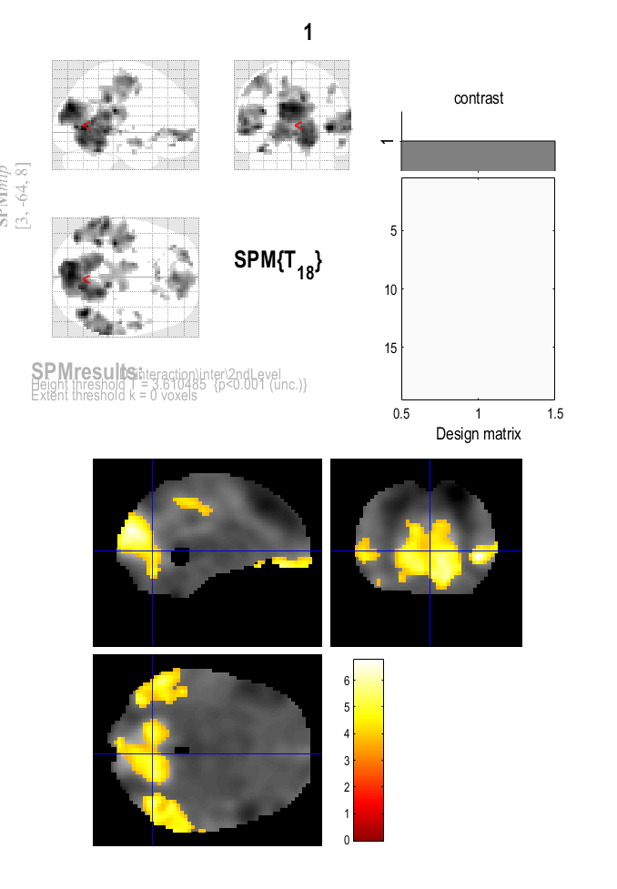
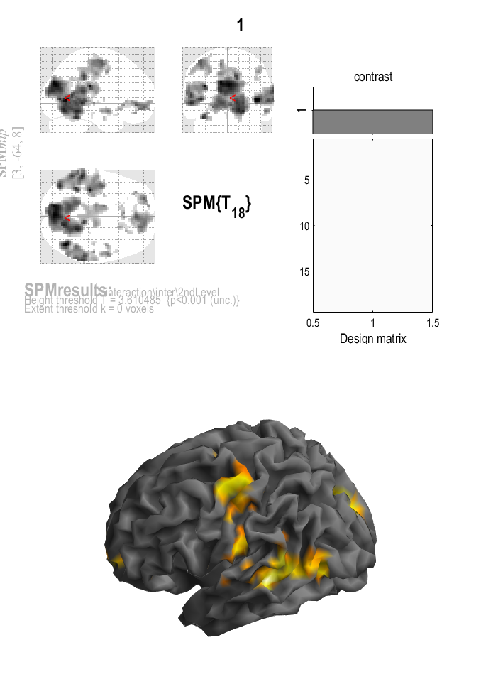
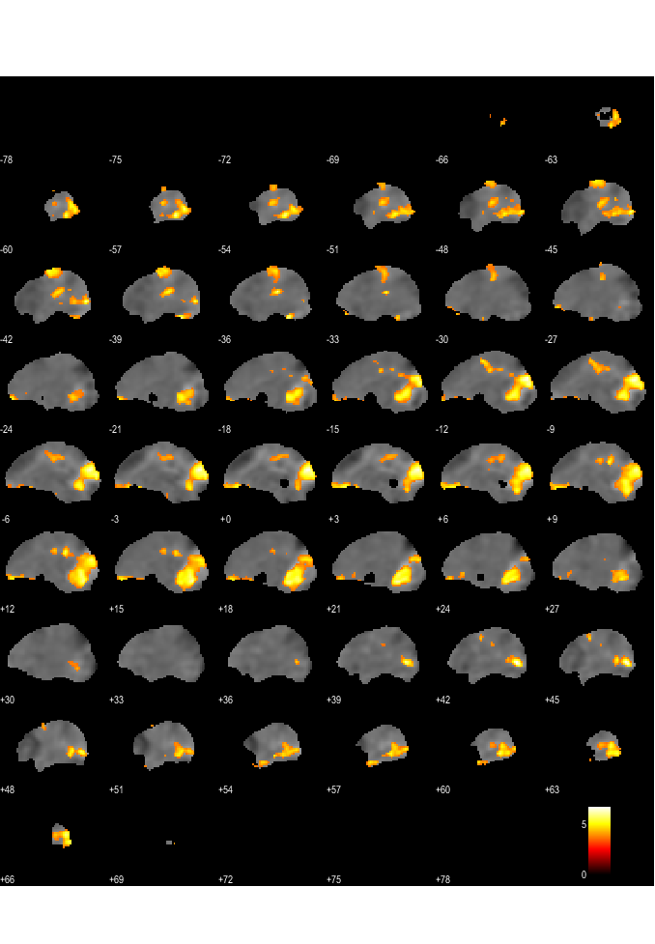
Group analysis of Shopping Interaction

Slide 13
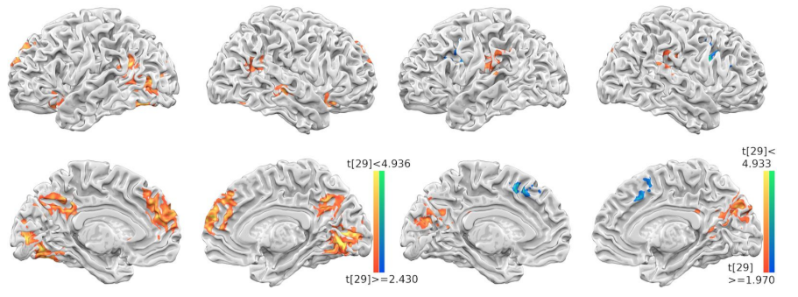
Group analysis of Shopping Interaction
This picture is from the paper “Consensus-seeking and conflict-resolving ---an fMRI study on college couples’ shopping interaction”

Slide 14
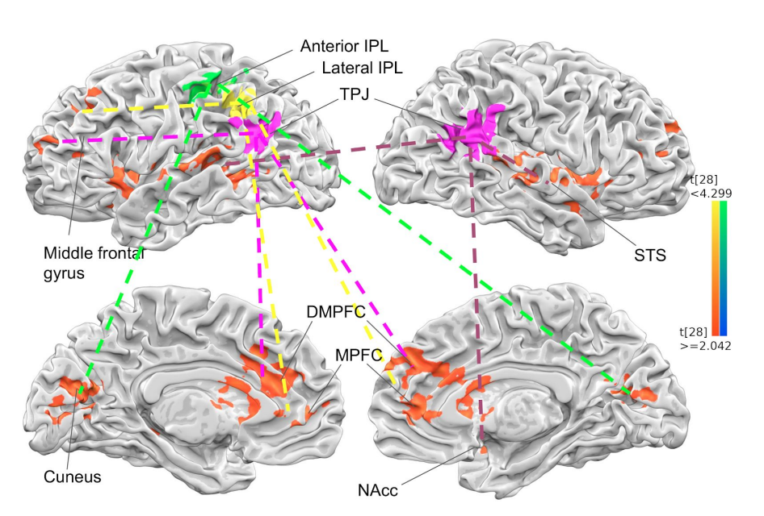
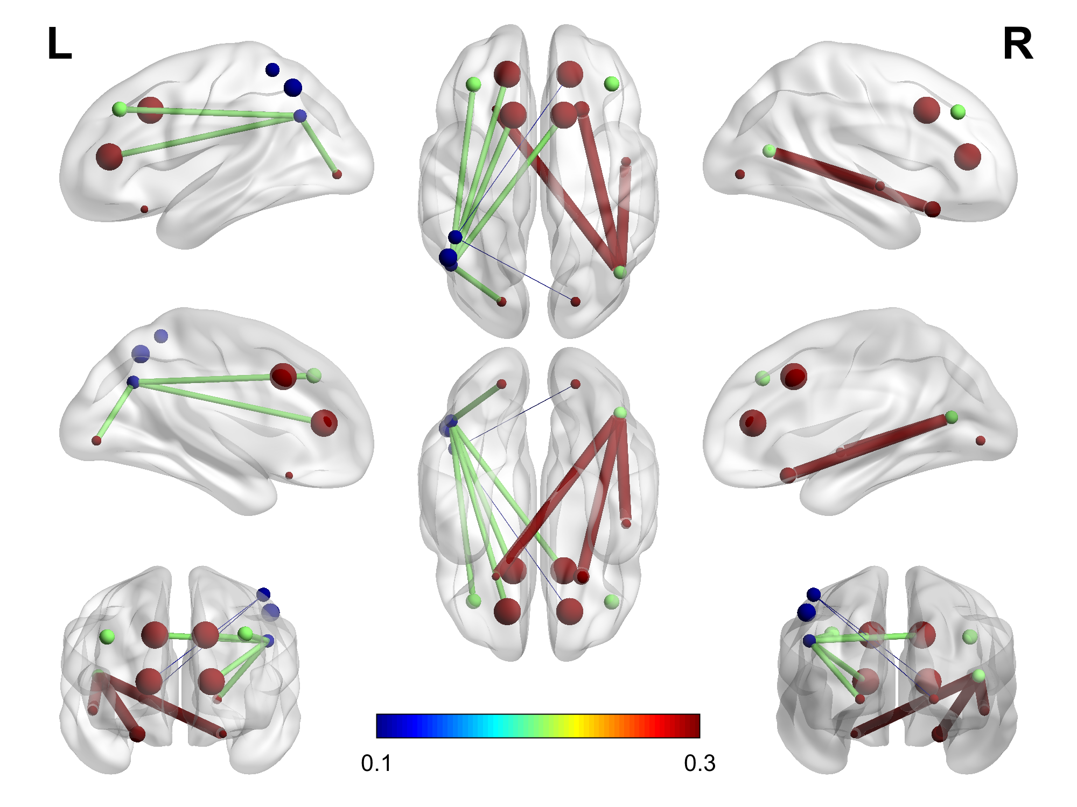
PPI results
This picture is from the paper “Consensus-seeking and conflict-resolving ---an fMRI study on college couples’ shopping interaction”

